Slide 1
Final Project - Group 02 CSYE6200 Concepts of Object-Oriented Design
Student Information System
Shravan Kumar Sai Prabhakar (002416030)
Mathesh Ramesh (002413401)
Rishabh Sharma (002470410)
Monica Sriramreddy (002641657)
Sameeth Kumar Goud Talla (002810105)

Slide 2




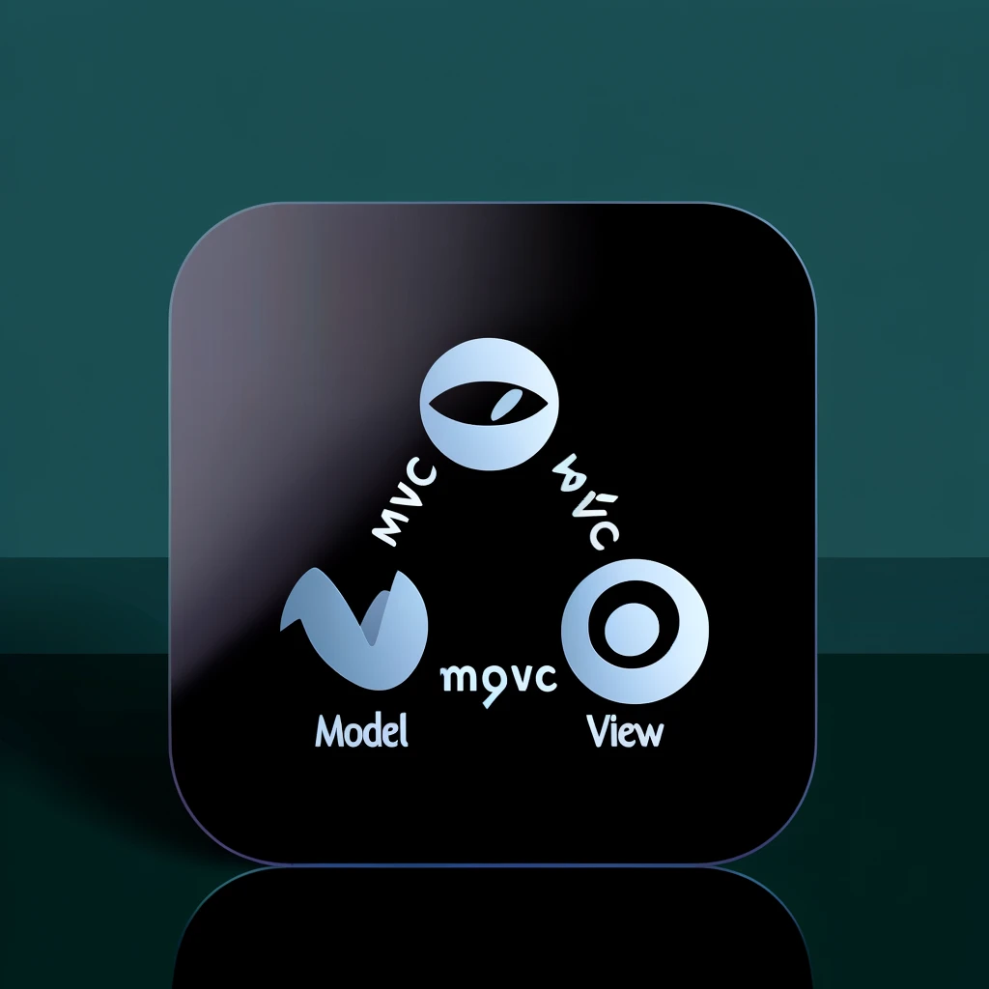
Technologies Java JAVA AWT GUI With Swing mySQL Database

Slide 3
Introduction
The Student Information System
application is made to make it easier for teachers and students to register together. It also keeps track of students' immunization anniversaries effectively, making sure that rules about health are followed and updates are made on time.

Slide 4
Features
🚀 Simplified Access: Navigate via our easy information panel, specifically created for Student Care Managers.
📅 Registration Renewals: Reinvented Easily track annual renewals for instructors and students. Goodbye to paper traces, and welcome to digital efficiency!
📧Health Alert Hub: Automate vaccination reminders due to ensure every child is protected on time.
✍️ Easy Enrollment: Registration for students and instructors is now a breeze. Data capture? Immediate and accurate.
📚 Vaccination Verification Vault: Maintain vaccination records without clutter. A system that is straightforward, brief, and easy to understand.
📋 Legal Liaison: Assign students to instructors by state legislation, without second-guessing. Classroom Cohesion: Arrange pupils and teachers by legal guidelines. Structured, sorted, and state authorized.

Slide 5
Object Oriented Design
Abstraction
Inheritance
Encapsulation
Polymorphism

Slide 6
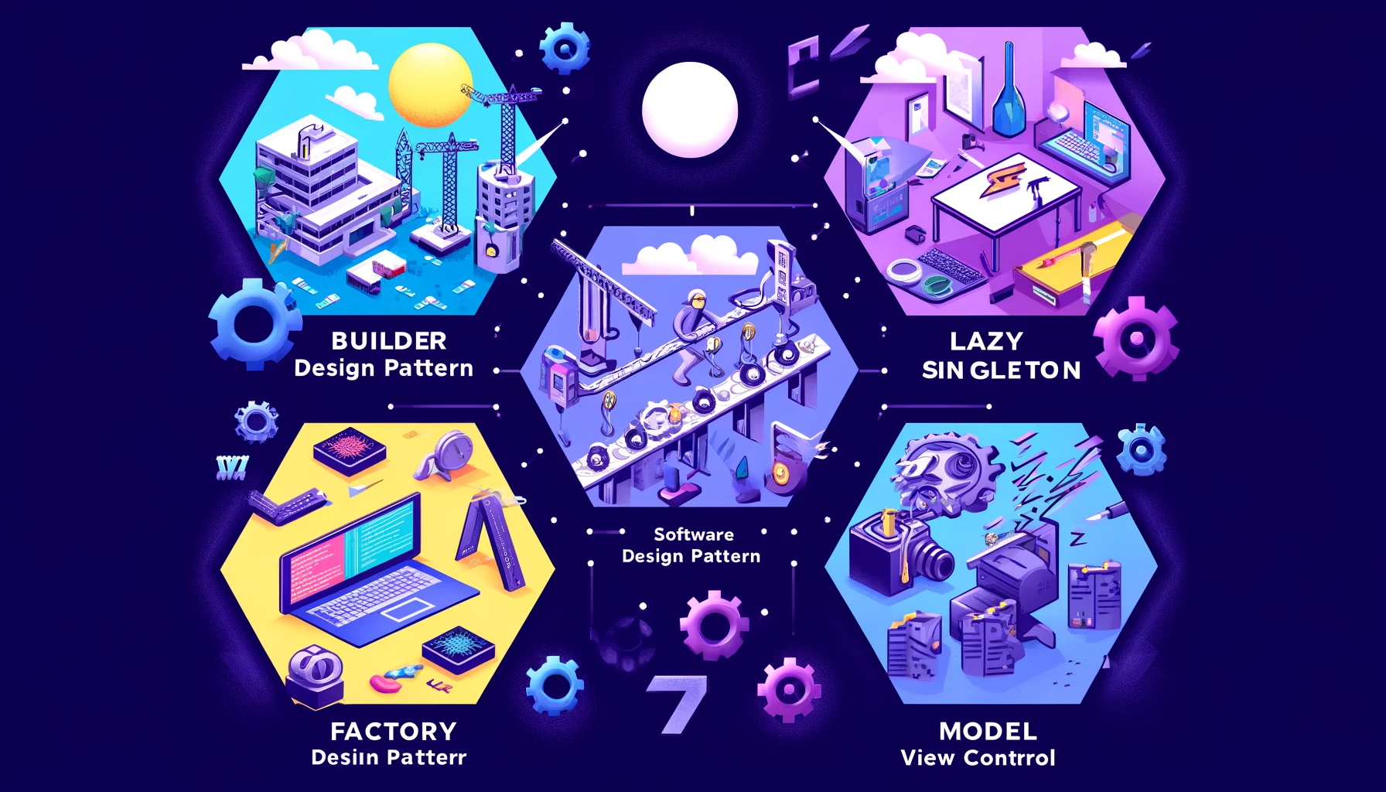
Design Patterns

Slide 7
MVC Design Pattern
Model
View
Controller
The View component acts as the visual interface for the program, orchestrating all of its user interface behaviors.
Controllers act as conductors, allowing communication between the Model's data structures and the View's presentation layer, managing business logic, responding to user input, and organizing data flow to produce the final visual result.
The Model element encapsulates the system's data-centric functionality, including all of the logic required to handle the data that the user interacts with.

Slide 8
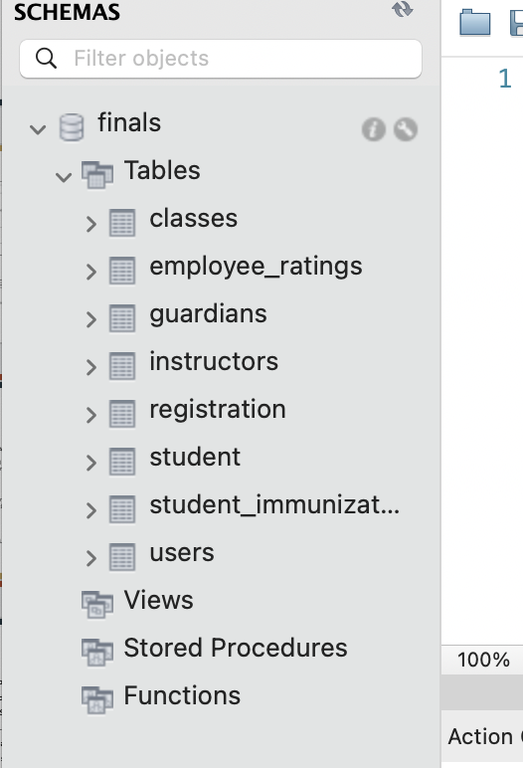
Database
Used MySQL for the database

Slide 9
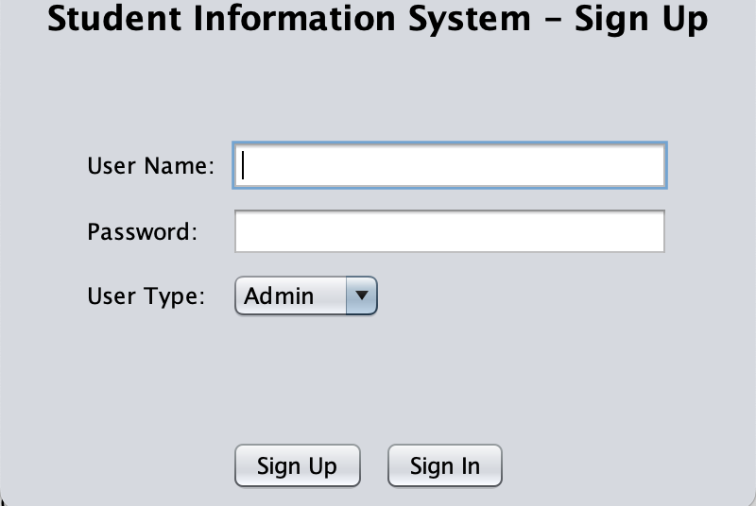
Sign Up Page

Slide 10
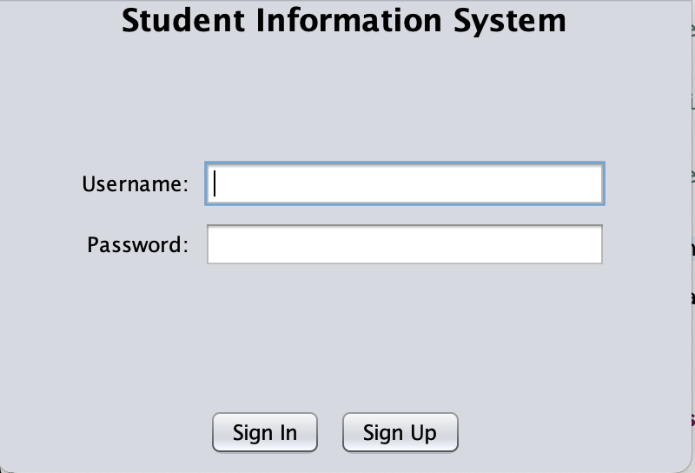
Sign in Page

Slide 11
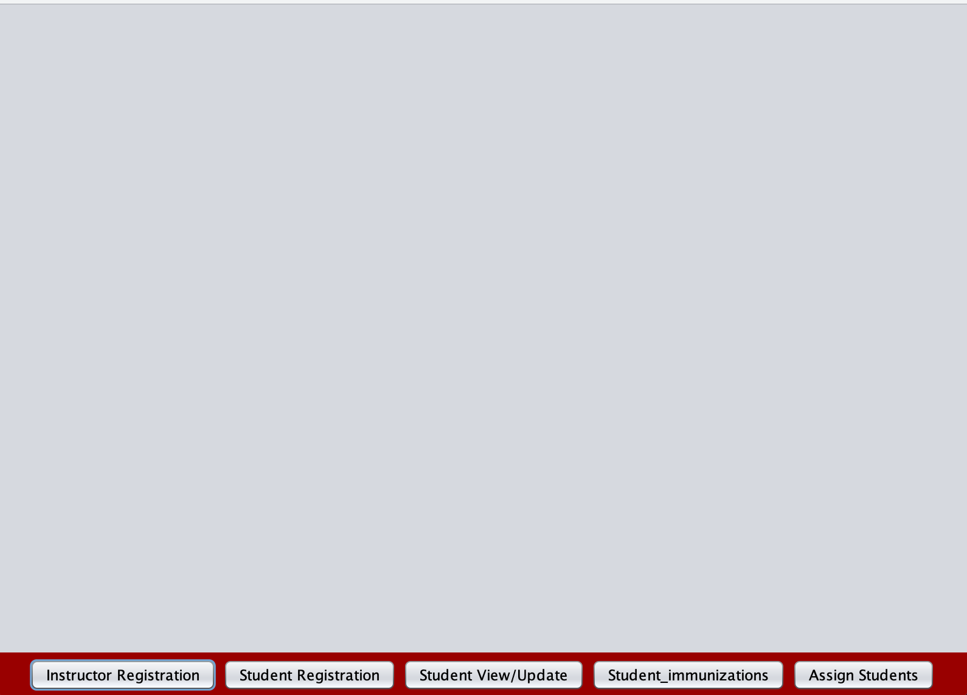
Home (Admin View)

Slide 12
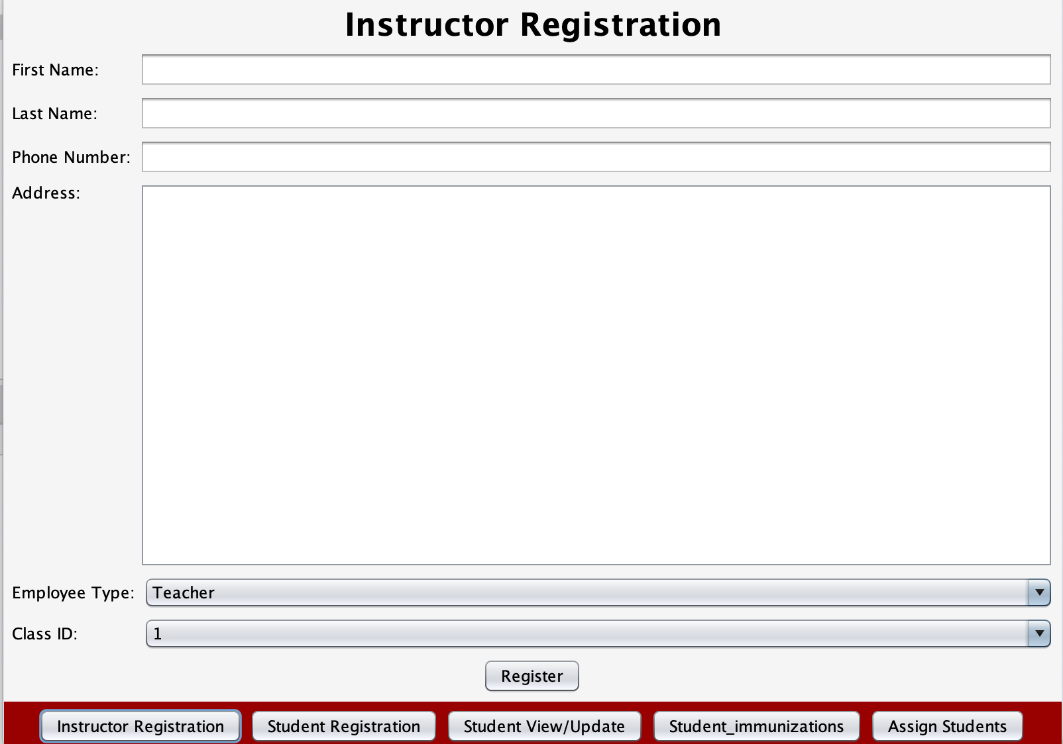
Instructor Registration (Admin View)

Slide 13
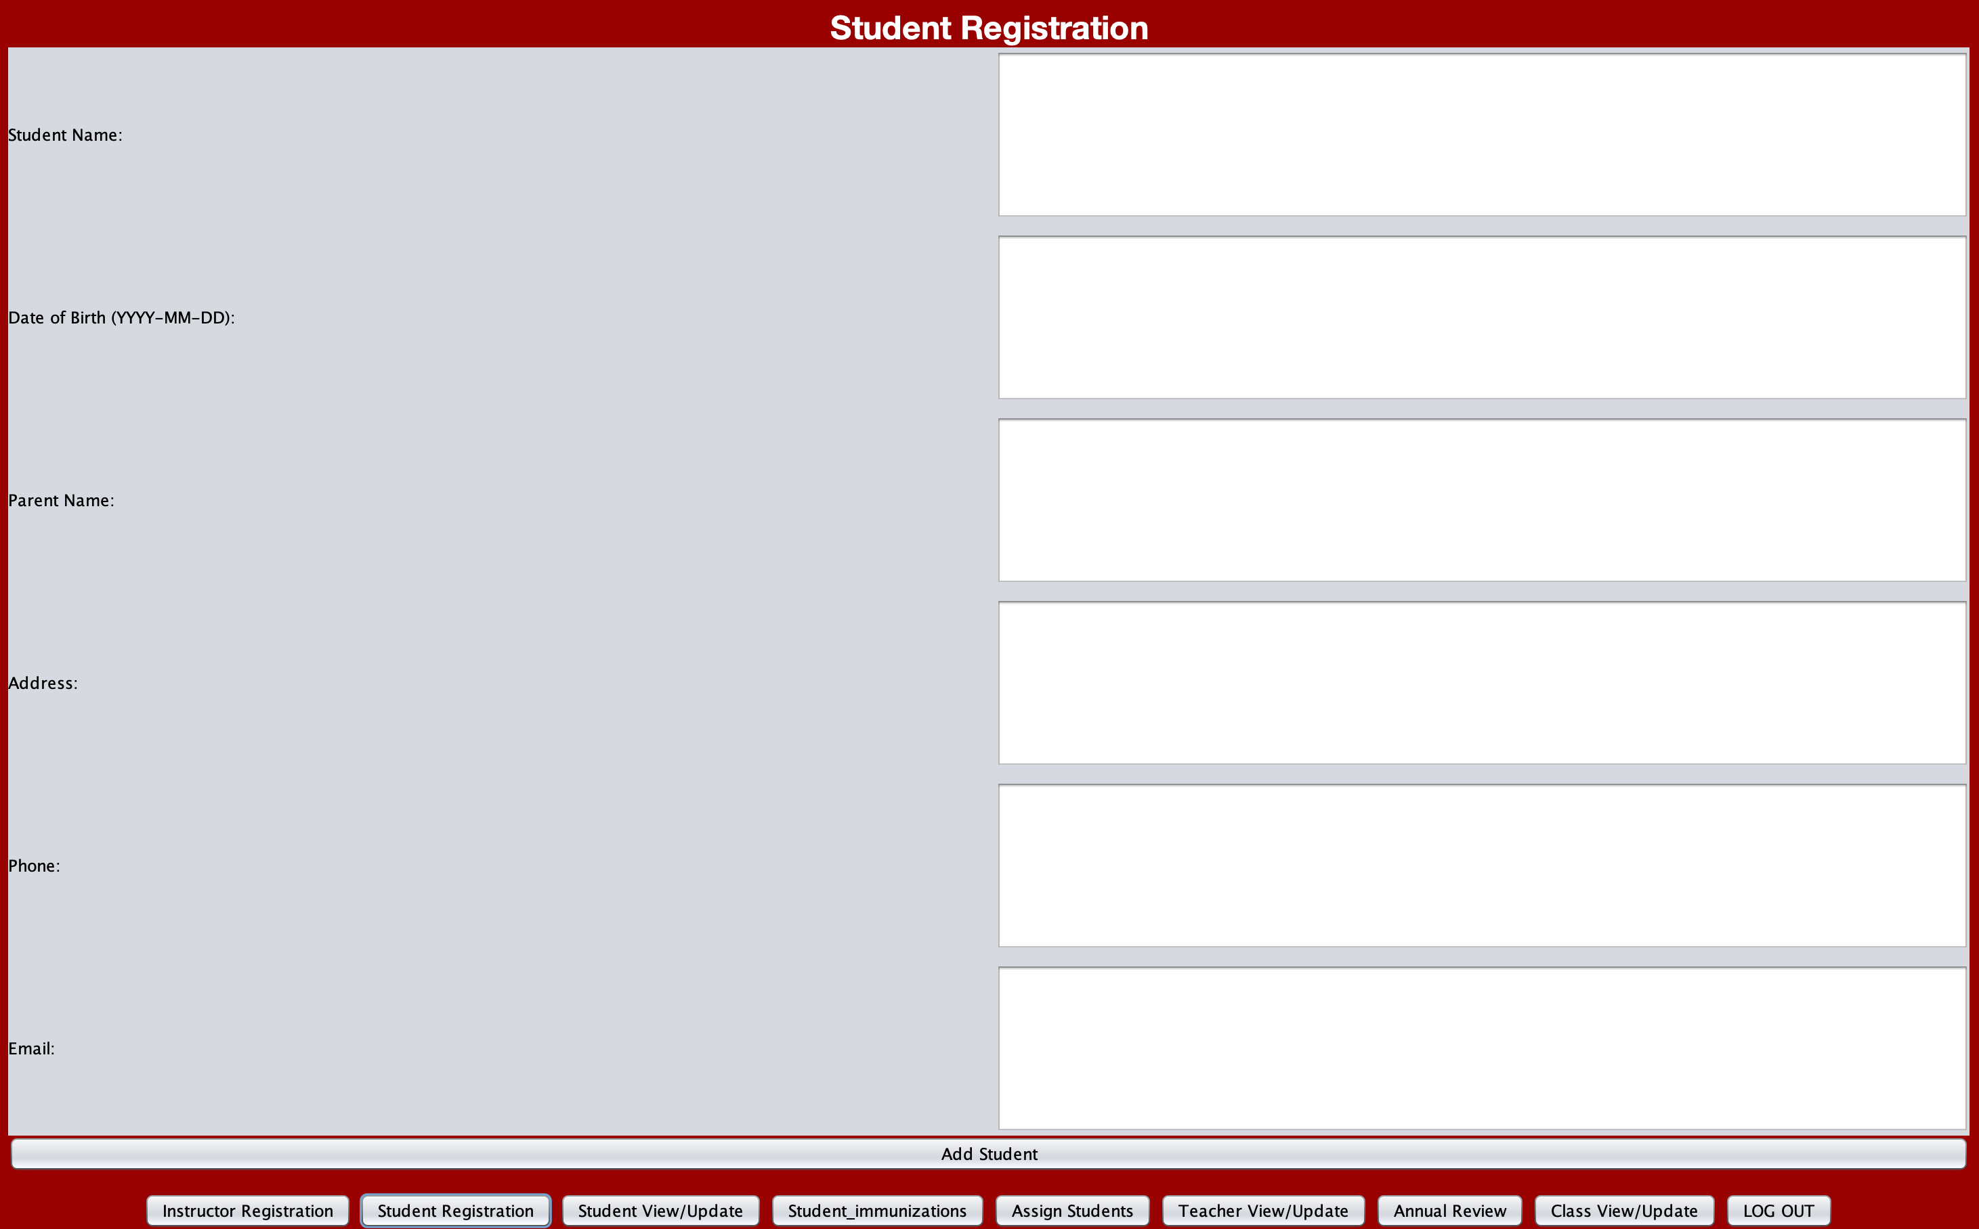
Student Registration

Slide 14
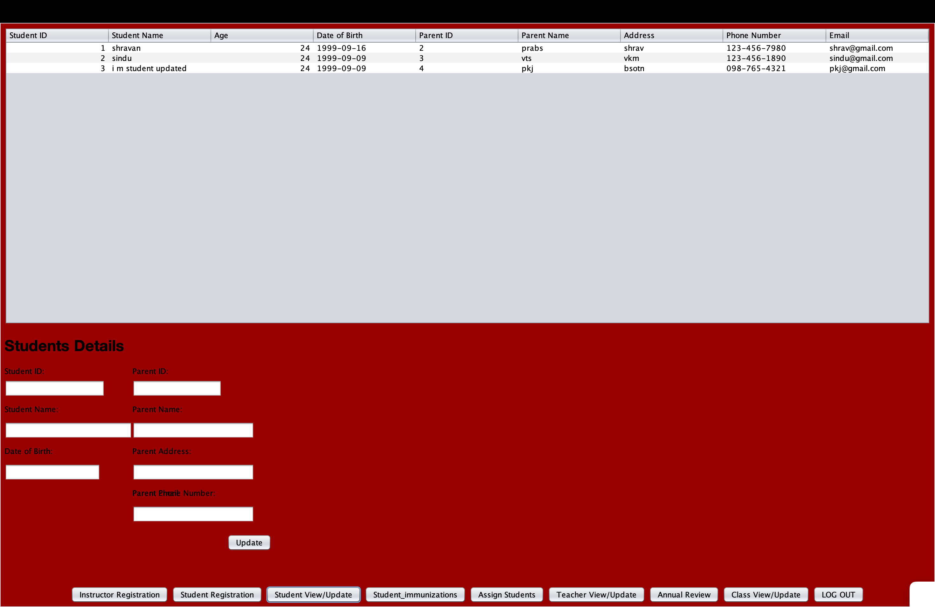
Student Details (Admin View)

Slide 15
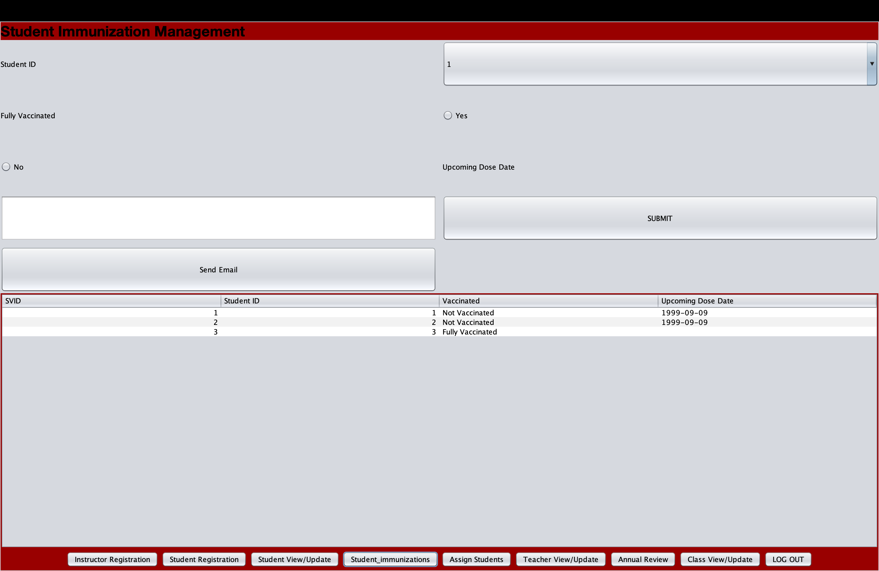
Student Immunization Management (Admin View)

Slide 16
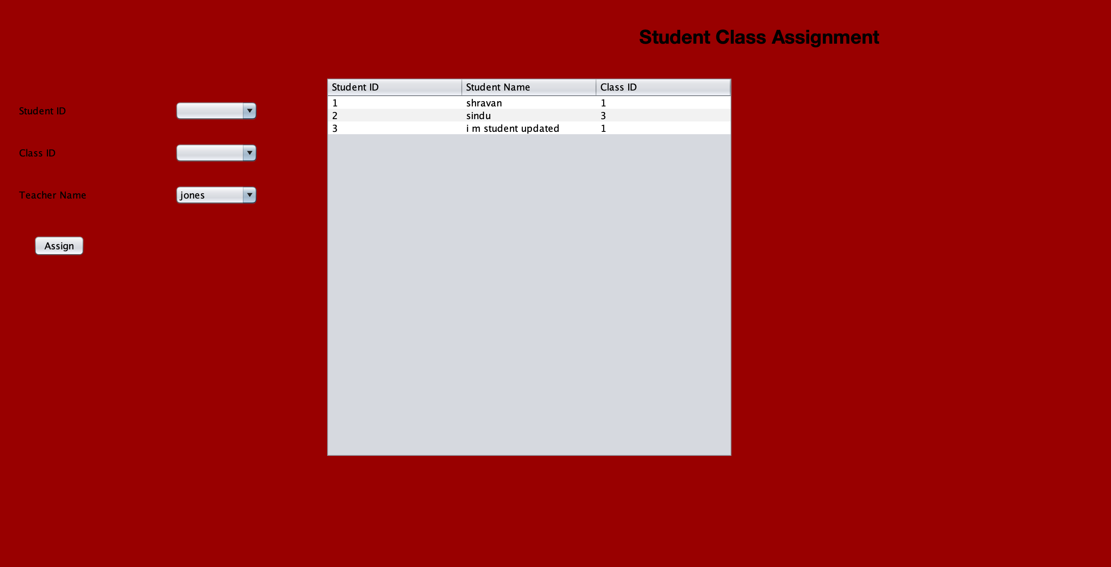
Student Class Assignment (Admin View)

Slide 17
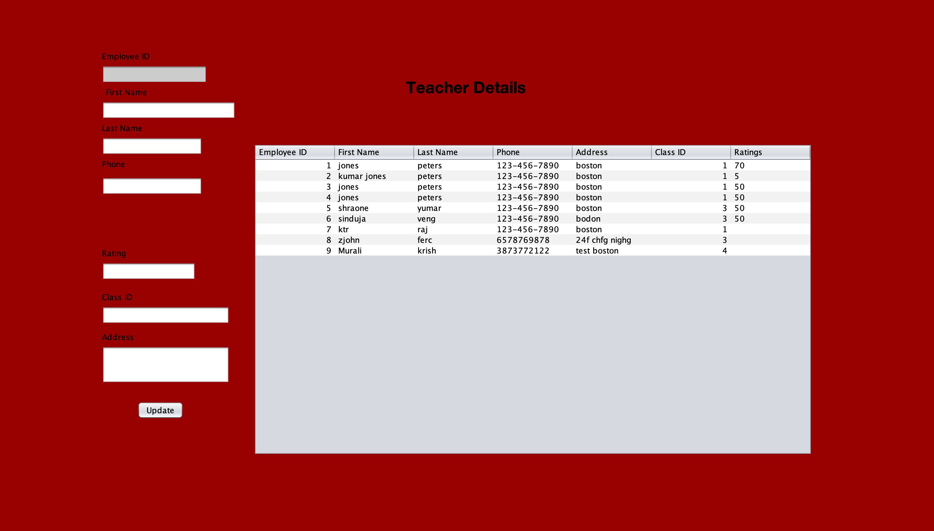
Teachers Details (Admin View)

Slide 18
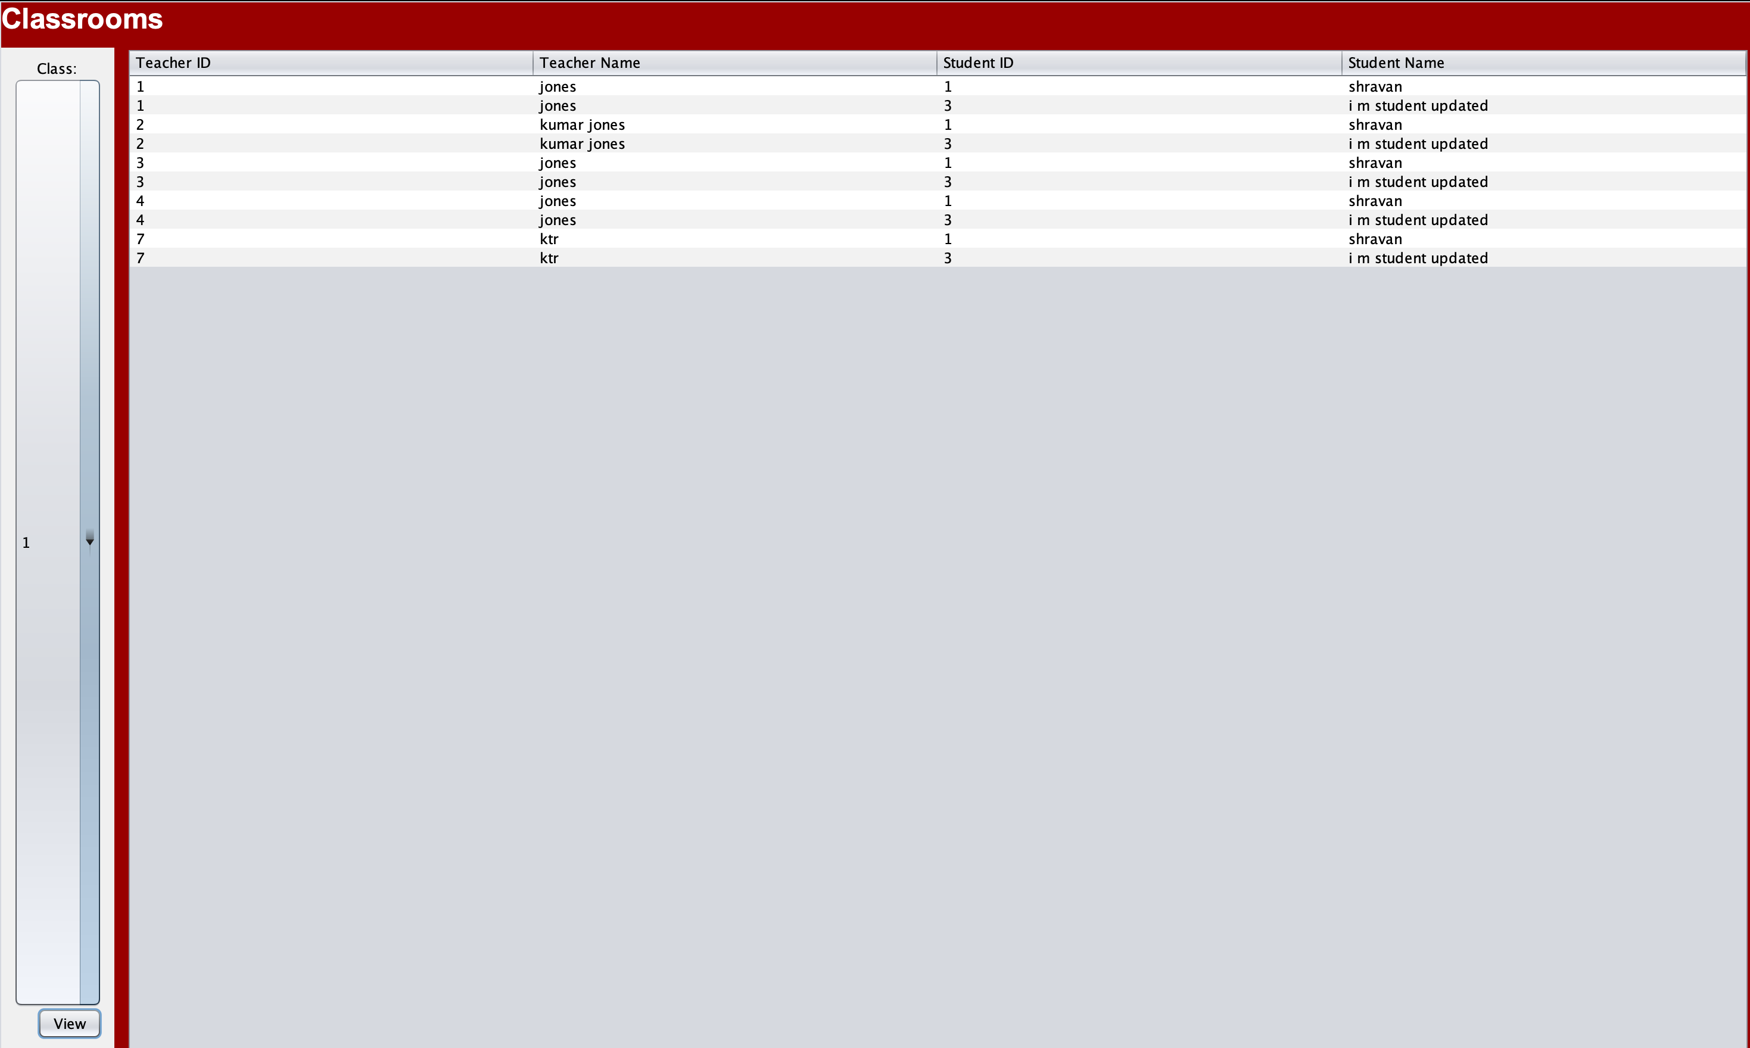
Class Rooms Details (Admin View)

Slide 19
Future Improvement
To improve user interaction, the frontend React integration and the backend Java application using Spring Boot are combined.
Transferring to a cloud-hosted setup with a microservice-deployed front end, back end.
NoSql Database

Slide 20
Contribution
Teacher Registration and view/update - Shravan Kumar Sai Prabhakar
Student Registration and view/update - Mathesh Ramesh
Immunizations and Assign students - Rishabh Sharma
Annual Review and class view/update - Monica Sriramreddy
Sign-in, Signup and presentation - Sameeth Kumar Goud Talla

Slide 21

Thank you

